Slide 1
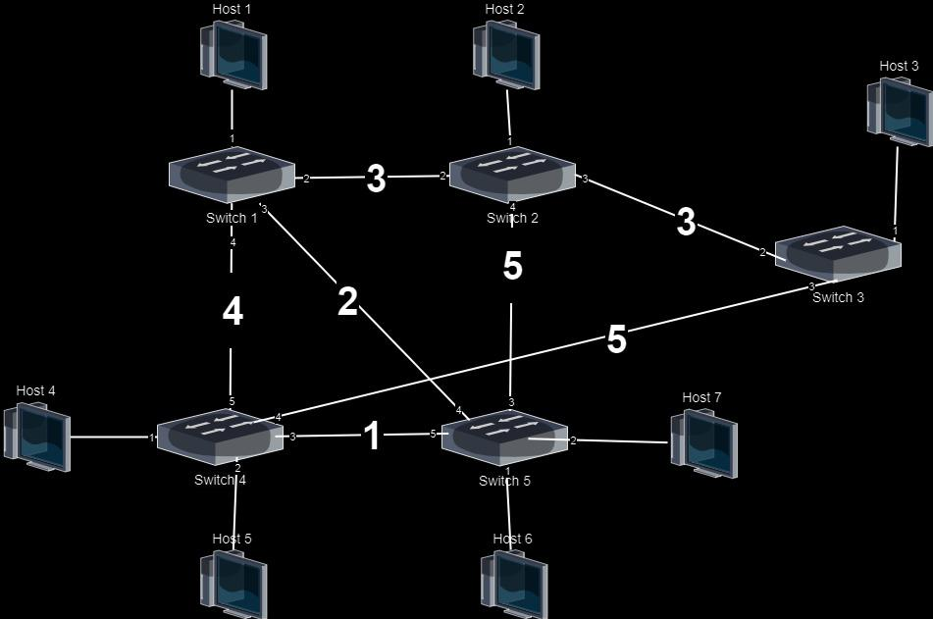
Network Slicing in SDN

Slide 2
Introduction
Goal
Implementation
Design choices

Slide 3
Network
Topology

Slide 4
Comprehension of the Problems
01
Extract network data (n. of switches, link capacities,...) from the Mininet Network to use it in the Software.py
Flows not having the right allocated bandwidth when link capacities already assigned
02
Automatically add flow tables in every switch, same thing when deleting
03

Slide 5
DEMO

